Slide 1
Everlasting Anonymous Rate-Limited Tokens
Rutchathon (Champ) Chairattana-Apirom (University of Washington)
Nico Döttling (CISPA)
Anna Lysyanskaya (Brown University)
Stefano Tessaro (University of Washington)

Slide 2






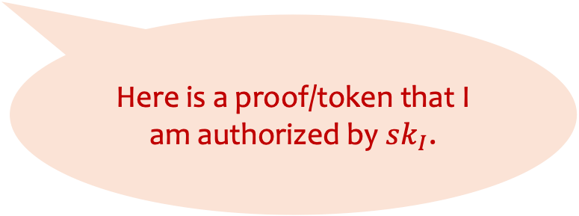

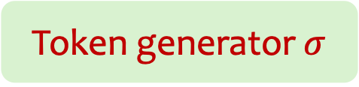
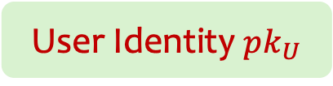

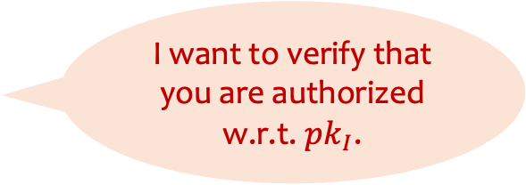

Anonymous Tokens
Issuer
Verifier
I want to verify that you are authorized w.r.t. $pk_{I}$.
$$sk_{I}$$
$$pk_{I}$$
Anonymity: Even if issuer and verifier collude, cannot link/track the user.
$$sn, π$$
Here is a proof/token that I am authorized by $sk_{I}$.
User Identity $pk_{U}$
User
$$pk_{I}$$
Token generator $σ$
Notes:
First, let me introduce the settings of anonymous tokens.
Here we have an issuer, user, verifier. The issuer has their own secret and public keys. We denote the user identity with some pk_U
The user interacts with the issuer to obtain token generator bound to the user identity.
The user wants to access some service provided by the verifier. The verifier will ask the users to authenticate themselves to be authorized by the issuer. The user then generates a token (which also contains a serial number) and send them to the verifier.
We also require anonymity to hold, meaning even if the issuer and verifier collude, they cannot link the user’s activity.
An example of this primitive is the Privacy pass protocol which is used to bypass captchas in browsers.

Slide 3
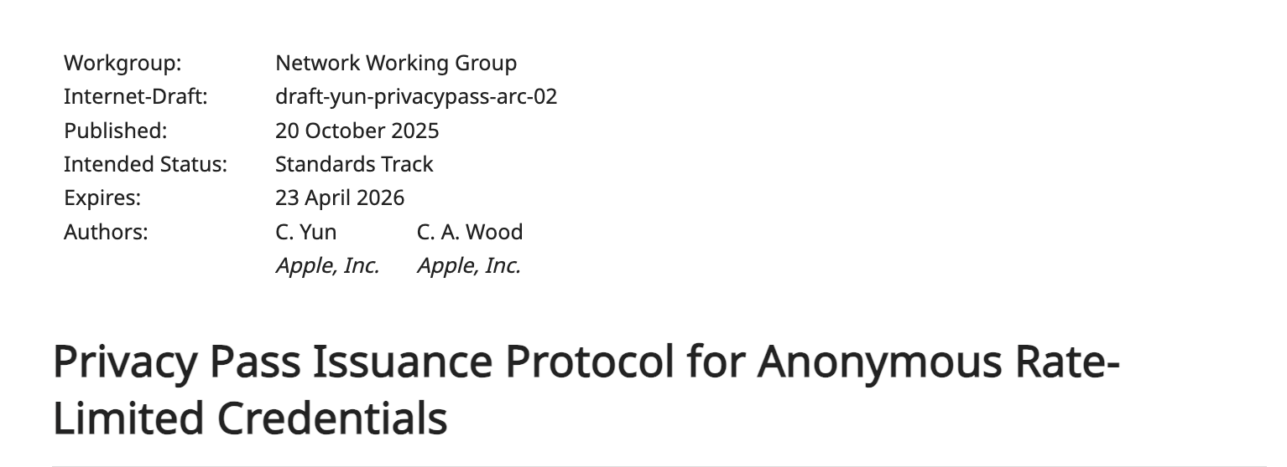
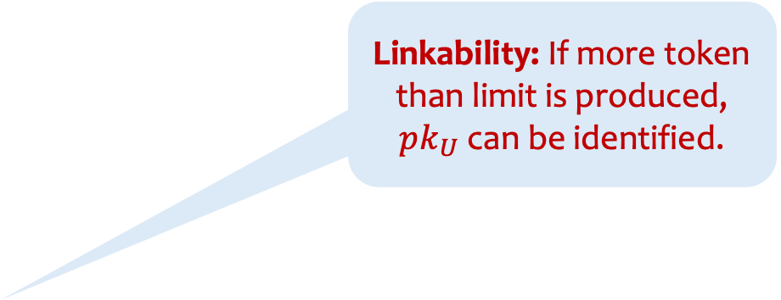
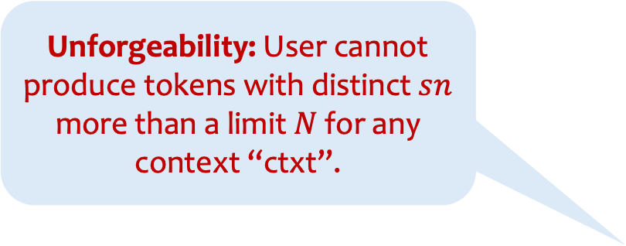

Rate-Limitation
Verifier
Issuer
ctxt = ‘blahblah.com’||date
$$sk_{I}$$
$$pk_{I}$$
Linkability: If more token than limit is produced, $pk_{U}$ can be identified.
Unforgeability: User cannot produce tokens with distinct $sn$ more than a limit $N$ for any context “ctxt”.
$$sn, π$$
Want some “rate-limiting” properties based on some “contexts”.
User Identity $pk_{U}$
User
$$pk_{I}$$
Token generator $σ$
Notes:
In some case, one might want to rate-limit the tokens: so that they can be used for specific context for a limited number of times.
For Example: accessing website but for limited time per day
The required security properties are unforgeability which says that (read out) and linkability which says that (read out) . We won’y focus on linkability in this talk.
We note that the rate-limited primitives such as credentials are being standardized in the IETF

Slide 4


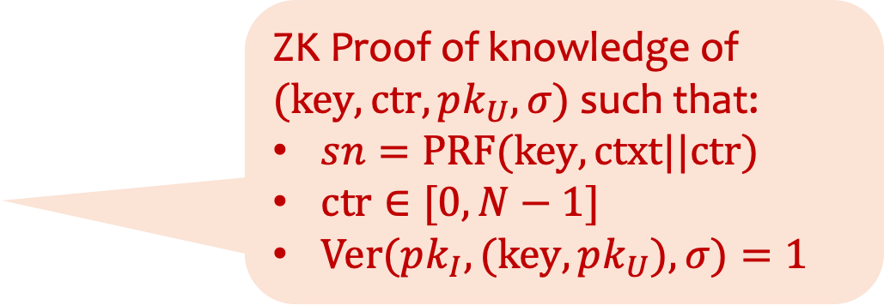
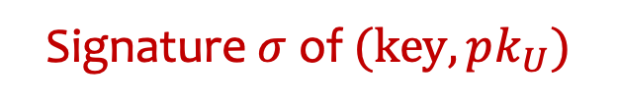




Prior Constructions [CHL’05, CHKLM’06]
Issuer
User
$$sk_{I}$$
$$pk_{I}$$
$$key←_{\$}$$
$$pk_{U}$$
Signature $σ$ of $(key,pk_{U})$
Verifier
Only computationally anonymous
ZK Proof of knowledge of
$(key,ctr,pk_{U},σ)$ such that:
$sn=PRF(key, ctxt||ctr)$
$ctr∈[0,N−1]$
$Ver(pk_{I},(key,pk_{U}),σ)=1$
ctxt = ‘blahblah.com’
$$sn←_{}PRF(key, ctxt||ctr)$$
$$π$$
Notes:
[2.5 minutes]
One particular way to achieve this property as shown in the e-cash protocol by Camenisch Hohenberger and Lysyanskaya is as follows:
In the issuance phase, the user samples a PRF key and interacts in a protocol where it receives a signature of the key and its identity.
To produce tokens, it computes the “serial number” by evaluating the PRF on ctxt || counter. Along with a proof of knowledge of the (prf key, coutner, pk_U, signature) that (1) serial number is computed correctly, (2) coutner is bounded by the rate-limit N, (3) signature is valid for key, pk_U w.r.t. issuer’s key.
The construction is unforgeable because if more than N tokens per context is given, then we know that there should be two tokens with the same counters => keys are different since sn are distinct (break unforgeability).
I note that this construction however only achieves computational anonymity due to sn computationally indist from random.

Slide 5

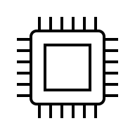

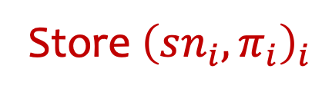
Post-Quantum Anonymity vs Unforgeability
Anon. Adversary
User
Unf. Adversary
Store ${\left(sn_{i},π_{i}\right)}_{i}$
De-anonymize past actions even after transitioning to PQ
After transition to PQ, we are fine.
Quantum
Computer
Quantum
Computer
Notes:
This can become a problem if the PRF is not post-quantum secure.
In particular, for post-quantum anon., even if we transition to PQ schemes, an adversary can still store the tokens and use quantum comp to deanonymize the users later on.
This is not an issue for unforgeability where after transitioning nothing can be done to the now un-used scheme.

Slide 6
Achieving Post-quantum Anonymity
Full-on post-quantum scheme (e.g., lattice-based)
Still quite inefficient
Notes:
With that said, there are a couple of ways to achieve PQ anon.
Post-quantum scheme. These are nice, but still quite inefficient.

Slide 7
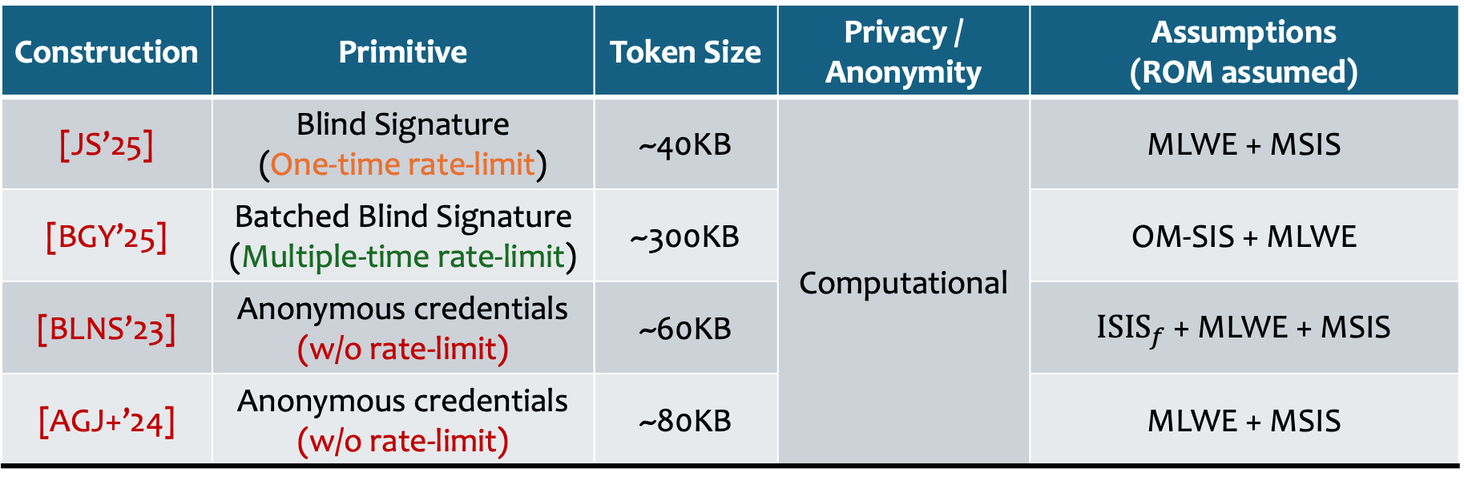
Lattice-Based Constructions of Similar Primitives
Construction | Primitive | Token Size | Privacy / Anonymity | Assumptions (ROM assumed)
[JS’25] | Blind Signature (One-time rate-limit) | ~40KB | Computational | MLWE + MSIS
[BGY’25] | Batched Blind Signature (Multiple-time rate-limit) | ~300KB |  | OM-SIS + MLWE
[BLNS’23] | Anonymous credentials (w/o rate-limit) | ~60KB |  | $ISIS_{f}$ + MLWE + MSIS
[AGJ+’24] | Anonymous credentials (w/o rate-limit) | ~80KB |  | MLWE + MSIS
Notes:
Here is also some token size for similar primitives (Note that the numbers might not be too accurate, but this proves the point with several tens-hundreds KBs of token sizes, especially for batched blind signatures case with multi-time rate-limiting guarantee that we want)
Blind signatures are one-time rate-limiting and batched blind gives similar guarantee to tokens.
For credentials, even without incorporating the PRF rate limiting, the sizes are still large.

Slide 8
Achieving Post-quantum Anonymity
Full-on post-quantum scheme
Still quite inefficient
Using a Post-Quantum PRF + group-based primitive
Proving correct PRF evaluation is expensive
Mixing assumptions, e.g., LWE + group-based
This work: what if we go further?
Group-based construction
Statistical / Everlasting Anonymity
Somewhat efficient
Notes:
Alternatively, one can also use a lattice-based PRF + group-based primitive.
However, the prover time would be quite large while these will also mix assumptions over different cryptographic structures.
In this work, we explore another alternative which is whether we can push group-based construction to be statistical/everlasting anonymous while still having some kind of efficiency.

Slide 9
Our Results
Pairing-based anonymous tokens construction with
Everlasting Anonymity
Unforgeability & Linkability from q-Type assumption + SXDH + ROM
Token generation time is independent of total number of tokens available per each token generator
Notes:
Our results is as follows:
We give a pairing-based construction with everlasting anonymity guarantee. Our unforgeability and linkability is based on q-type assumption + DDH + random oracle
Token generation time is independent of the bound on number of tokens per dispenser.
In this talk, I will mostly cover the definition of everlasting anon and our construction at a high-level.

Slide 10
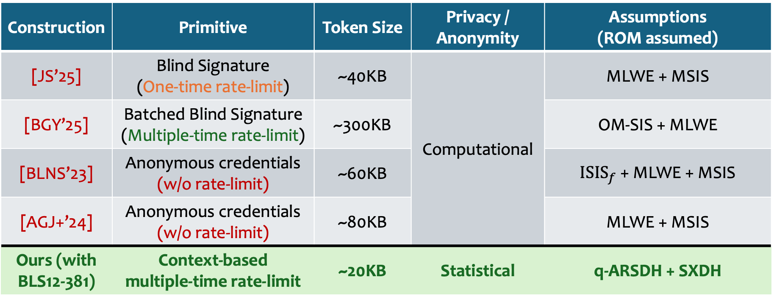
Comparison with Lattice-Based Constructions of Similar Primitives
Construction | Primitive | Token Size | Privacy / Anonymity | Assumptions (ROM assumed)
[JS’25] | Blind Signature (One-time rate-limit) | ~40KB | Computational | MLWE + MSIS
[BGY’25] | Batched Blind Signature (Multiple-time rate-limit) | ~300KB |  | OM-SIS + MLWE
[BLNS’23] | Anonymous credentials (w/o rate-limit) | ~60KB |  | $ISIS_{f}$ + MLWE + MSIS
[AGJ+’24] | Anonymous credentials (w/o rate-limit) | ~80KB |  | MLWE + MSIS
Ours (with BLS12-381) | Context-based multiple-time rate-limit | ~20KB | Statistical | q-ARSDH + SXDH
Notes:
This is comparison of our scheme with existing constructions. Note that our sizes are smaller and we have stat. anon.

Slide 11



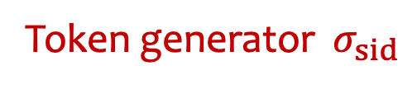




Definition of (Everlasting) Anonymity
$$pk_{U,uid}$$
NewUsr
Possibly malicious key
User
Real user or simulator
uid
$$pk_{U,uid}$$
sid, uid
$$crs$$
Token generator $σ_{sid}$
$$pk_{I}$$
sid,ctxt
Show
Real user or simulator
$$sn, π$$
Wins if guess correctly whether real or simulated
$$b′$$
Adversary $𝒜$
Notes:
Here is how we define anonymity
1. We have unbounded adversary acting as the issuer
2. it is given a CRS and can pick a malicious public key
3. A’s goal is to guess which world (real, simulated) it is in correctly. To do so, it has access to the following oracles
4. A newuser generating a pk of a user, a user oracle for issuance sessions with the adversary specifying the user ID and session ID, and finally the show oracle which the adv determines which token generator will be used by the sid of the issuance sessions.
Now let’s see how each of these oracles look like.

Slide 12
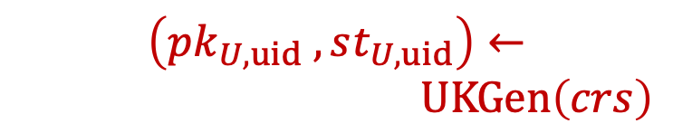

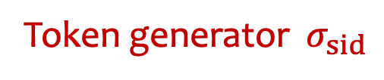

Anonymity: Real World
$$\left(pk_{U,uid} ,st_{U,uid}\right)←$$
$UKGen\left(crs\right)$
NewUsr
User
$$User\left(pk_{I},st_{U,uid}\right)$$
uid
$$pk_{U,uid}$$
sid, uid
Token generator $σ_{sid}$
$$crs$$
$$pk_{I}$$
sid,ctxt
Show
$$sn, π$$
Wins if guess correctly whether real or simulated
$$b′$$
Adversary $𝒜$
$$\left(sn,π,σ’_{sid}\right)←Show\left(pk_{I},σ_{sid},ctxt\right)$$
Notes:
Here is how the real-world looks like in the definition.
The new user oracle generates the pk_U along with some inner state of the user.
This state is then used by the user in the issuance sessions with the malicious issuer
The token generator obtained by the user is then used during showing to produce the tokens, with some changes made to its state.

Slide 13
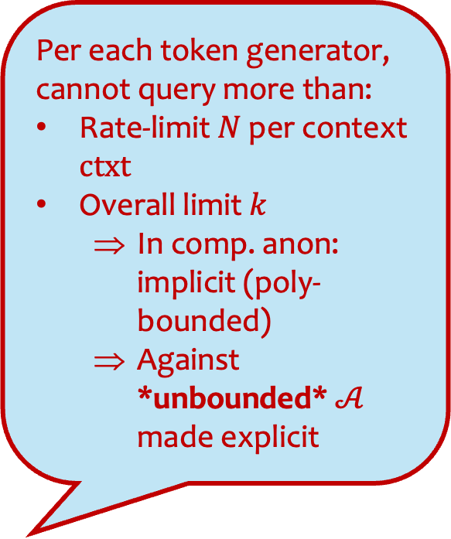


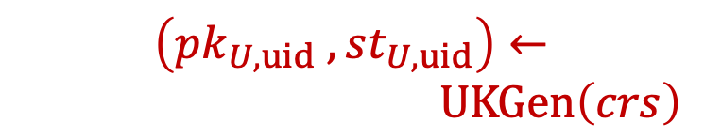
Anonymity: Ideal World
Per each token generator, cannot query more than:
Rate-limit $N$ per context $ctxt$
Overall limit $k$
In comp. anon: implicit (poly-bounded)
Against *unbounded* $𝒜$ made explicit
$$\left(pk_{U,uid} ,st_{U,uid}\right)←$$
$UKGen\left(crs\right)$
NewUsr
$$Sim_{1}\left(pk_{I},pk_{U,uid}\right)$$
User
uid
$$pk_{U,uid}$$
sid, uid
$$crs$$
$$pk_{I}$$
sid,ctxt
Show
$$sn, π$$
Wins if guess correctly whether real or simulated
$$b′$$
Adversary $𝒜$
$$(sn,π)←Sim_{2}\left(pk_{I}\right)$$
Notes:
In the ideal world, the simulator at
Issuance only knows the user’s identity,
while at showing it only knows the public key of the adversary.
Note that the simulator does not keep any states.
Moreover, we remark that there are restrictions to how the show oracle can be queried.
In particular, A cannot ask for more than N tokens per token generator. And importantly, it cannot ask for more than k tokens per generator.
In computational notion, this is implicitly bounded by some poly. For unbounded A, however, we need to specify them concretely, otherwise, adversary can make unbounded number of queries and figure out the underlying user.

Slide 14



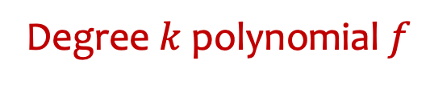
Strawman Solution: Random Degree-k Polynomial
Issuer
User
$$sk_{I}$$
$$pk_{I}$$
$$key←_{\$}$$
$$pk_{U}$$
Signature $σ$ of $(key,pk_{U})$
Verifier
Only computationally anonymous
Degree $k$ polynomial $f$
ctxt = ‘blahblah.com’
$$sn←_{}PRF(key, ctxt||ctr)$$
$$sn←f(ctxt||ctr)$$
$$π$$
Notes:
To achieve everlasting anonymity, we first try to replace the PRF with random degree-k polynomial to ensure that the serial numbers will look random for at most k tokens.

Slide 15


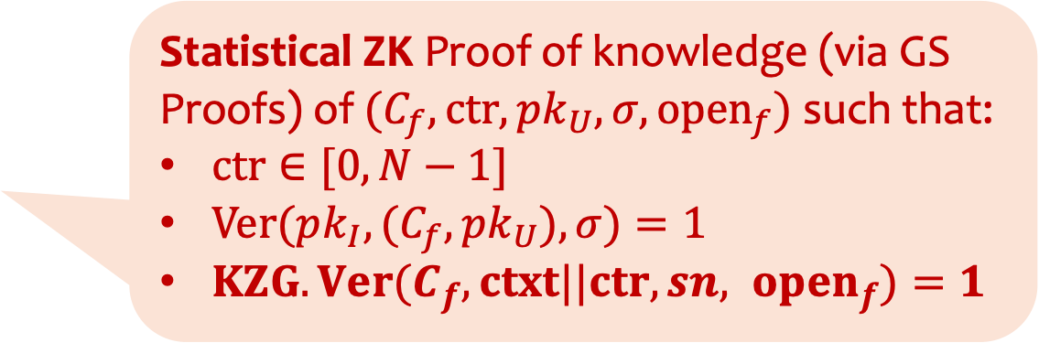
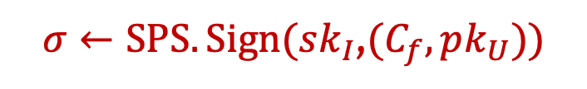

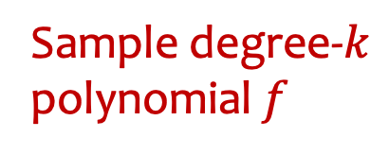
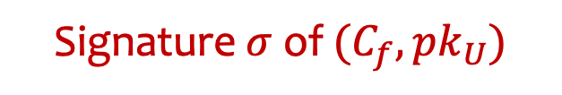


Everlasting Anonymity via (1) k-wise independence of the polynomial, (2) statistical hiding of KZG commitment, and (3) statistical ZK.
Structure-preserving signatures (SPS) signing group elements
[KZG’10] Polynomial commitment
Issuer
User
$$pk_{U},C_{f}←KZG.Com(f)$$
$$sk_{I}$$
Sample degree-$k$ polynomial $f$
$$pk_{I}$$
$$pk_{U}$$
$σ←SPS.Sign(sk_{I}$,$(C_{f},pk_{U}))$
Signature $σ$ of $(C_{f},pk_{U})$
Verifier
Statistical ZK Proof of knowledge (via GS Proofs) of $(C_{f},ctr,pk_{U},σ,open_{f})$ such that:
$ctr∈[0,N−1]$
$Ver(pk_{I},(C_{f},pk_{U}),σ)=1$
$KZG.Ver(C_{f}, ctxt||ctr,sn, open_{f})=1$
ctxt = ‘blahblah.com’
$$sn←f(ctxt||ctr)$$
$$π$$
Notes:
Fleshing this out, the user first sample the polynomial.
1. commit to it using a KZG commitment
2. Sign the pk_U and the comm. using structure preserving signatures
3. Using the signature we can produce the following proof of knowledge which proves similar relation to before, except that instead of proving that the computation of f is done correctly, we prove that the user “knows” a corresponding evaluation opening to the signed commitment instead. (Mention Groth-Sahai for the pairing-product equations check)
4. Note that here we achieve anonymity through k-wise independence, statistical hiding of KZG commitment, and statistical ZK.

Slide 16


Structure-preserving signatures (SPS) signing group elements
[KZG’10] Polynomial commitment scheme
Downside: Running time scales linearly with $k$ per each token generation!
Issuer
Sample degree-$k$ polynomial $f$
User
$$pk_{U},C_{f}←KZG.Com(f)$$
$$sk_{I}$$
$$pk_{I}$$
$$pk_{U}$$
$σ←SPS.Sign(sk_{I}$,$(C_{f},pk_{U}))$
Signature $σ$ of $(C_{f},pk_{U})$
Verifier
Statistical ZK Proof of knowledge (via GS Proofs) of $(C_{f},ctr,pk_{U},σ,open_{f})$ such that:
$ctr∈[0,N−1]$
$Ver(pk_{I},(C_{f},pk_{U}),σ)=1$
$KZG.Ver(C_{f}, ctxt||ctr,sn, open_{f})=1$
ctxt = ‘blahblah.com’
$$sn←f(ctxt||ctr)$$
$$π$$
Notes:
The downside of this construction, however, is that computing the serial number and opening now runs in time linear in this bound k “per each token generation”

Slide 17
Our approach at a high-level
Replace a random polynomial with info-theoretic secure PRF with fast evaluation [Pagh-Pagh’08,BHNK’19]
Still commit to function keys with KZG and sign with SPS
Structure of the keys allow some preprocessing of the openings
Notes:
To fix this, we do the following.
We replace the polynomial
Still commit to function keys with KZG commitments, but due to the structure of the function keys, some openings can be precomputed, allowing for faster token generation time.

Slide 18


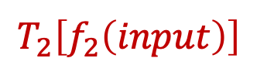


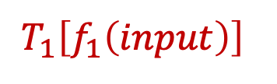
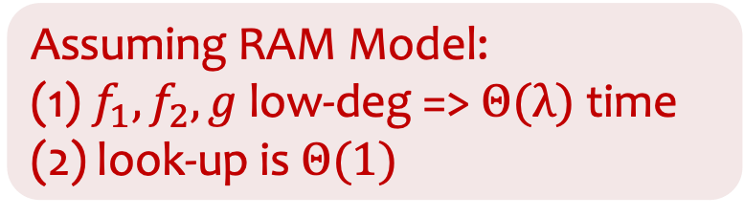
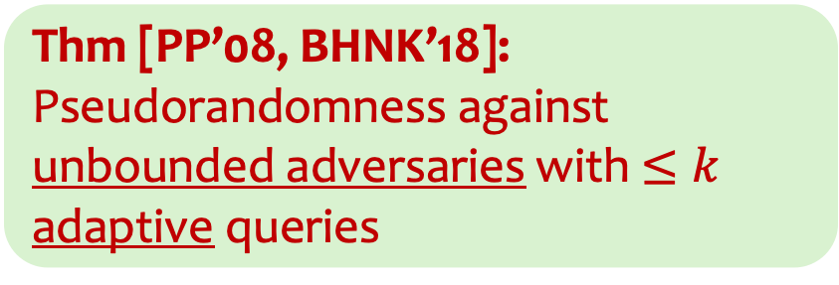
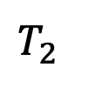
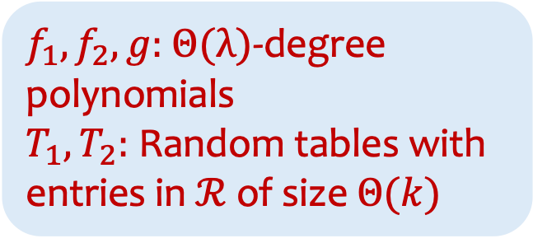
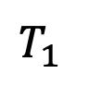


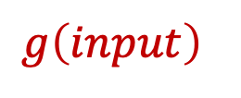
Statistically Pseudorandom Function with faster evaluation [Pagh-Pagh’08,BHNK’19]
$$input∈𝒟$$
$f_{1},f_{2},g:$ $Θ(λ)$-degree polynomials
$T_{1},T_{2}:$ Random tables with entries in $ℛ$ of size $Θ(k)$
$$f_{1}$$
$$f_{2}$$
$$g$$
Assuming RAM Model: (1) $f_{1},f_{2},g$ low-deg => $Θ(λ)$ time (2) look-up is $Θ(1)$
$$T_{1}$$
$$T_{2}$$
$$T_{2}\left[f_{2}\left(input\right)\right]$$
Thm [PP’08, BHNK’18]: Pseudorandomness against unbounded adversaries with $≤k$ adaptive queries
$$g\left(input\right)$$
$$T_{1}\left[f_{1}\left(input\right)\right]$$
$$output∈ℛ$$
Notes:
To give some idea on how the function works,
1. We have the input fed to three functions f1, f2, g
2. Then, the output of f1, f2 are used as an index to large look-up tables T1 T2.
3. Finally, the output of g and these table entries are summed together to the output
Note that in this construction, f1, f2, g are only security-parameter -wise independent functions and T1, T2 are random tables of size linear in k. Assuming that one can lookup the tables in constant time, the running time now only relates to computing f1,f2, g and doing the lookups. (in the RAM model).
It is already known that this construction satisfies "pseudorandomness" against unbounded adveraries with at most k adaptive query to evaluation oracle. (Pseudorandom against ... w/o evaluation oracle... )

Slide 19
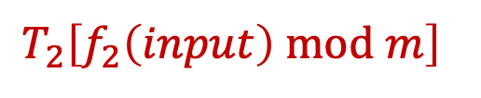
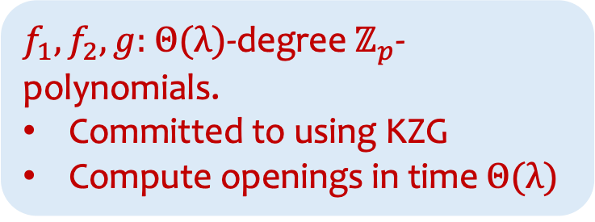

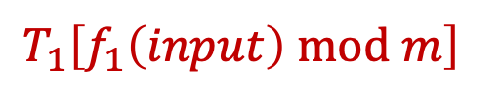


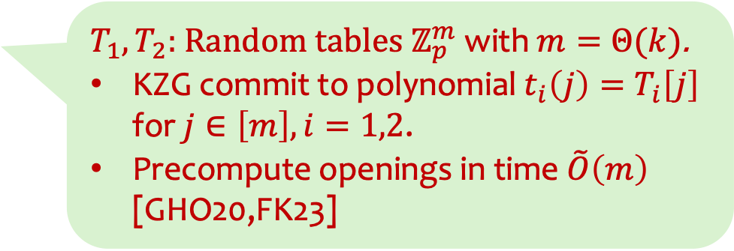

Modifications amenable to group-based techniques
$f_{1},f_{2},g:$ $Θ(λ)$-degree $ℤ_{p}$-polynomials.
Committed to using KZG
Compute openings in time $Θ(λ)$
$$input∈ℤ_{p}$$
Proved via Inner-Product Argument (e.g., bulletproof)
$$f_{1}$$
$$f_{2}$$
$$g$$
$$mod m$$
$$mod m$$
$$T_{1}$$
$$T_{2}$$
$T_{1},T_{2}:$ Random tables $ℤ_{p}^{m}$ with $m=Θ(k)$.
KZG commit to polynomial $t_{i}\left(j\right)=T_{i}\left[j\right]$ for $j∈\left[m\right], i=1,2$.
Precompute openings in time $\tilde{O}\left(m\right)$ [GHO20,FK23]
$$T_{2}\left[f_{2}\left(input\right) mod m\right]$$
$$g\left(input\right)$$
$$T_{1}\left[f_{1}\left(input\right) mod m\right]$$
$$output∈ℤ_{p}$$
Notes:
To make the construction work with group-based techniques, we made some small modifications.
1. Domain and range are now Zp. f1, f2, g are Zp-polynomials. They will be committed to via KZG. Evaluating and computing will be in time O(\lambda)
2. The outputs of f1, f2 are modded down to the range [0, m-1] and used as indices to T1 T2.
3. These two tables are also committed to via KZG by committing to the polynomial which evaluates on each index to the corresponding entry. Note that since we know in advance where the openings are going to be, we can precompute these openings.
The modulo computation are more complicated but can be proved via inner-product argument with similar complexity to the range proof that was already used.

Slide 20
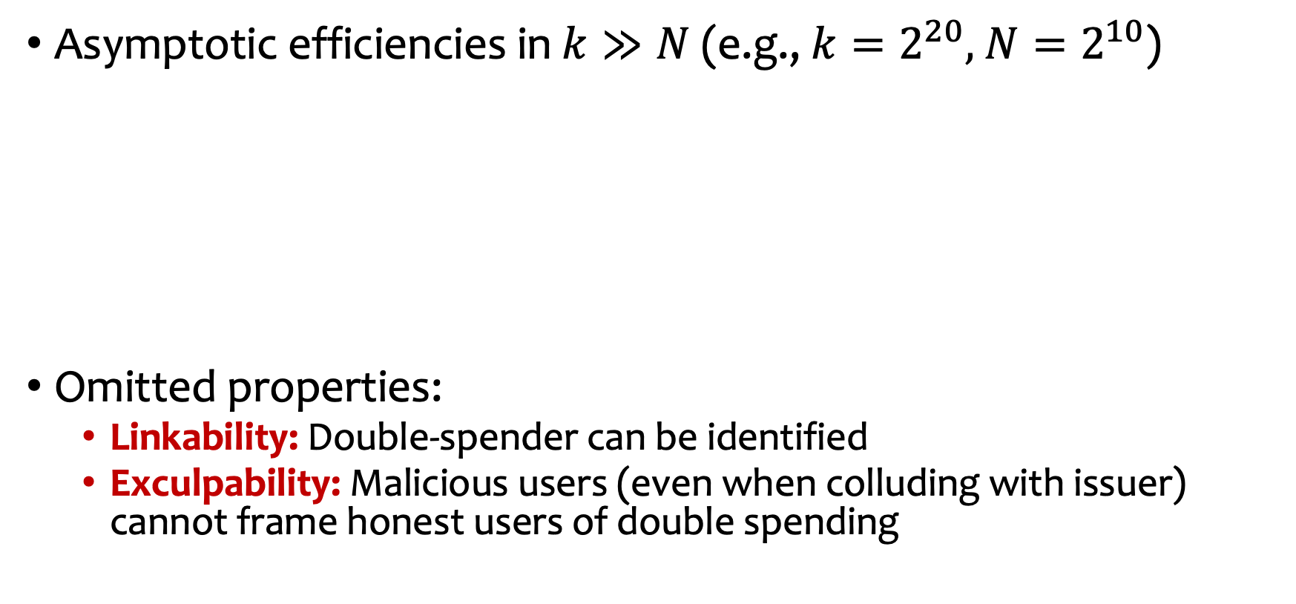
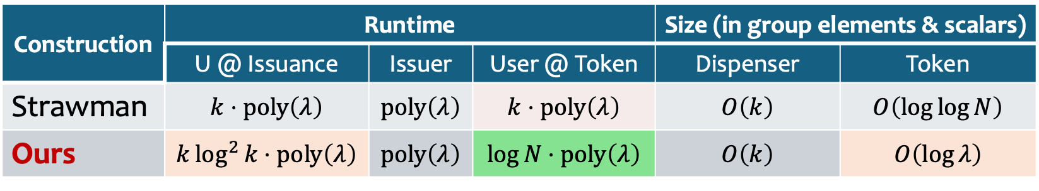
Summary
Asymptotic efficiencies in $k≫N$ (e.g., $k=2^{20},$ $N=2^{10}$)
Omitted properties:
Linkability: Double-spender can be identified
Exculpability: Malicious users (even when colluding with issuer) cannot frame honest users of double spending
Construction | Runtime |  |  | Size (in group elements & scalars)
 | U @ Issuance | Issuer | User @ Token | Dispenser | Token
Strawman | $$k⋅poly\left(λ\right)$$ | $$poly\left(λ\right)$$ | $$k⋅poly\left(λ\right)$$ | $$O\left(k\right)$$ | $$O\left(\log{\log{N}}\right)$$
Ours | $$k\log^{2}{k}⋅poly\left(λ\right)$$ | $$poly\left(λ\right)$$ | $$log⁡N⋅poly\left(λ\right)$$ | $$O\left(k\right)$$ | $$O\left(\log{λ}\right)$$
❌
✅
Notes:
Now, just to give a summary.
- We improve from the strawman construction by eliminating the dependency on k per each token generation
- This is paid by larger token sizes and slightly larger user time at issuance
- In this talk, I omitted how we achieve other properties such as linkability and exculpability. The latter ensures that no malicious users can frame honest users for double spending.

Slide 21
Future Directions
Can we get a more efficient construction?
Using stronger models (AGM or GGM)?
Shorter proofs but more computation overhead, e.g., Plonk?
Avoiding structure-preserving signatures?
Implementations?
Best-of-both-worlds: Everlasting anonymity + Post-Quantum unforgeability?
Thank you!! Please check out ePrint: 2025/1030

